Slide 1
Task Manager
Tammie Illg, Aysia Clay, Jared Pierce

Slide 2
Table Of Contents
Scope
01
02
Structure
03
Database
04
C
05
Bash
Script
06
Reflection
Notes:
Tammie

Slide 3
01
Scope
Overview/Goal of project
Notes:
Tammie

Slide 4
Scope
Target audience: individuals and teams seeking a tool for personal or collaborative task management
User friendly that allows individuals to create, modify, and delete tasks
Set reminders and automate task-related activities using Bash Scripting
Create User
Notes:
Tammie

Slide 5
02
STRUCTURE
Flowchart/Algorithms
Notes:
Tammie introduces Structure and Aysia

Slide 6
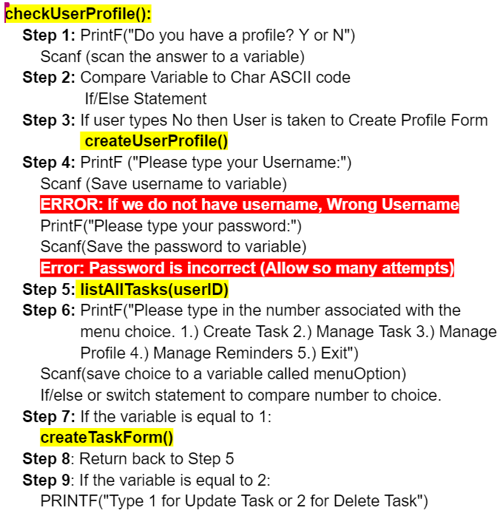
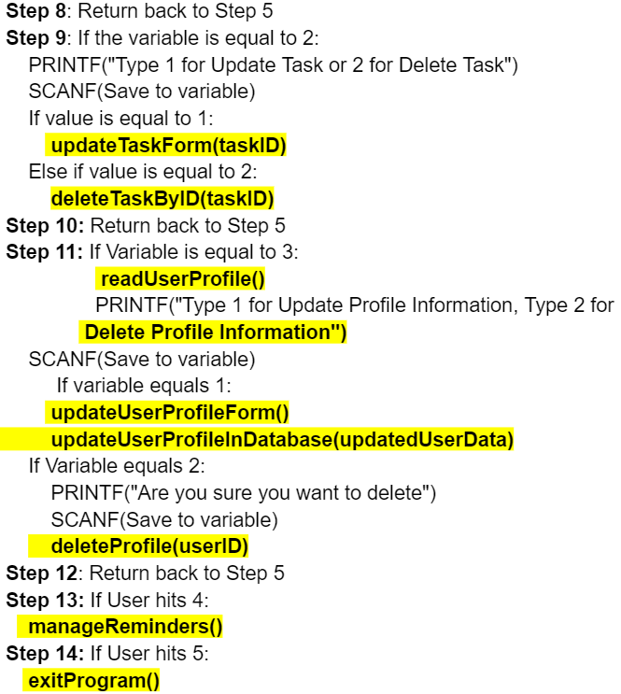
Flowchart & Algorithms (Pseudo Code)
Notes:
Aysia

Slide 7
03
DATABASE
Database Schema/Commands/Procedures & Triggers
Notes:
Jared

Slide 8
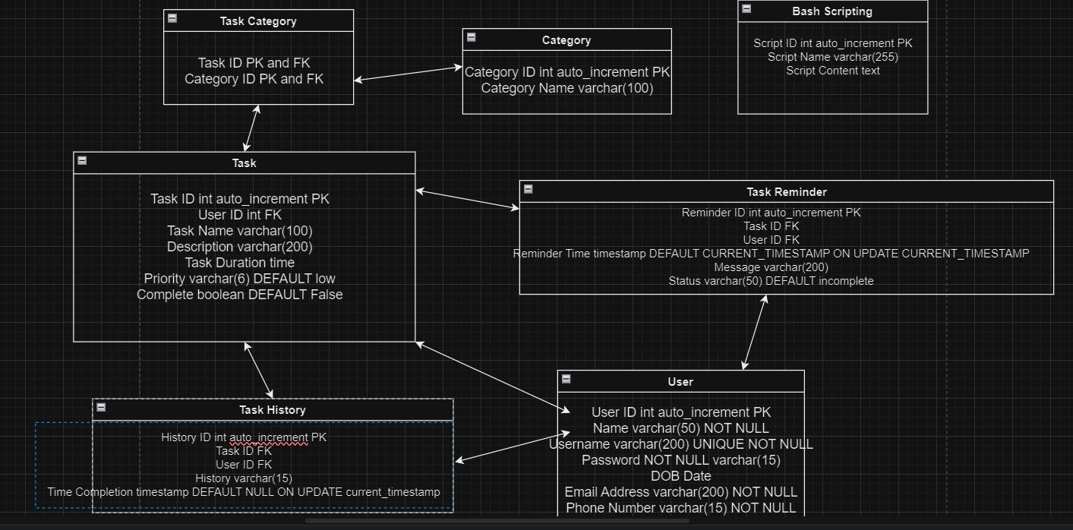
Schema and Tables
Notes:
Jared:
The overall idea for the database was to give users the freedom when creating a task, similar to everyday task trackers that we have today, but we also want to make sure that the user can only access their own tasks and not be able to access another person’s tasks. Which is why we have the username set to unique. And just like any other app we’d need an email, phone, and password to be not null in order to create a profile.
The task table again reflects the freedom to allow a user to input whatever info they deem necessary when creating a task.
The task history table tracks complete/incomplete tasks, the category table we created to provide a list of category names if a person cannot think of one to assign to their task, which leads to the task category table that would hold that info.
The task reminder table allows the user to create a reminder for a specific task and then with the bash scripting could automate a message to their desktop or email.

Slide 9
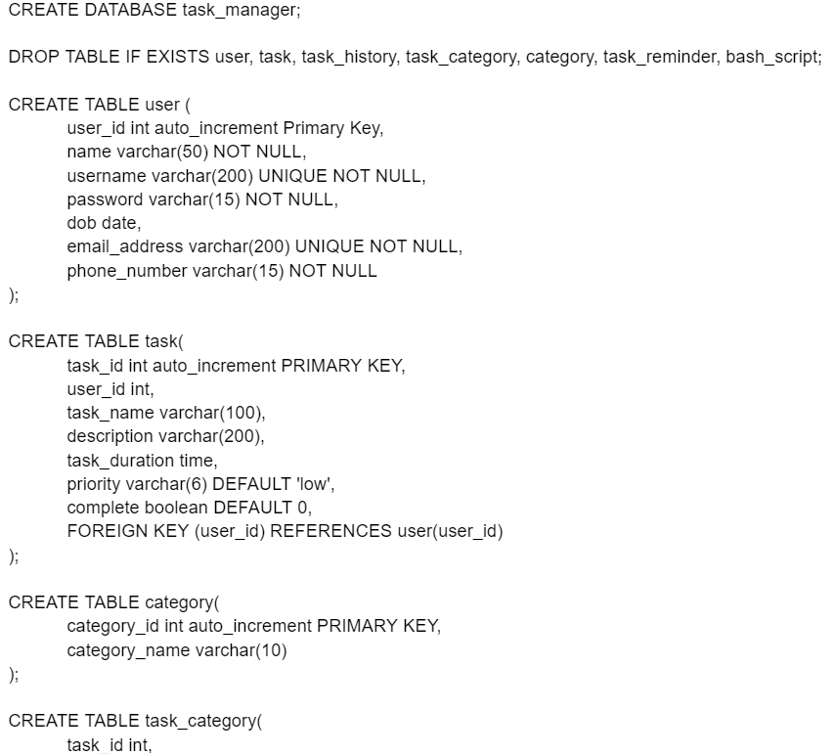
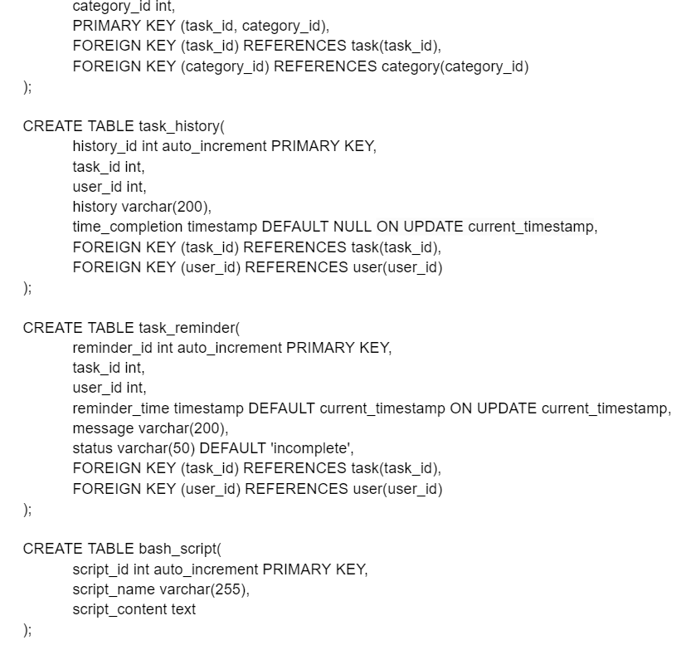
DDL Commands
Notes:
Jared:
These are the Data Definition Language Commands to create the database and tables along with the constraints and primary/foreign keys to establish relationships between the tables

Slide 10
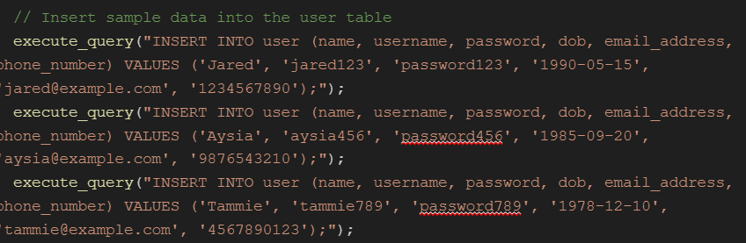
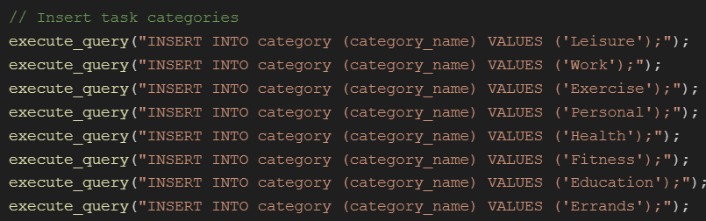
DML Commands
Notes:
Jared:
This screenshot is a sample of our logic for Data Manipulation Language commands that we ran on the start up of our program to have sample data to test and work with

Slide 11
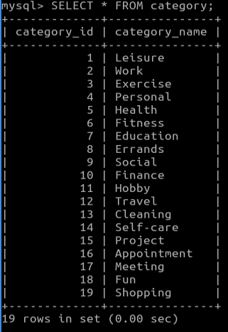
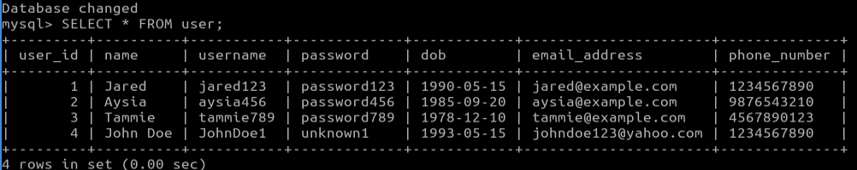
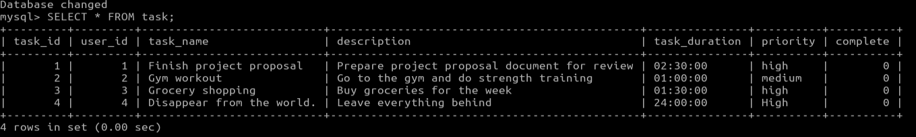
DML Commands Results
Notes:
Jared:
This is just to show the results from the previous slide which then leads into the next slide…

Slide 12
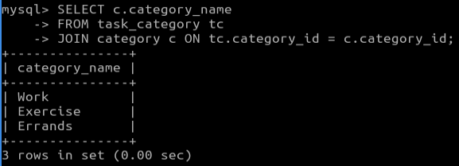
DQL Commands
Notes:
Jared:
Our Data Query Language command results. This is to show all the category names that were inserted into the database, the tasks, and users.

Slide 13
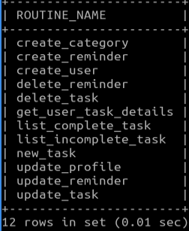
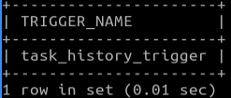
Stored Procedures/Triggers
Cleaner and better readability when writing out the logic for our function
Trigger helped insert into task_history table without the need of C
Notes:
Jared:
Read slide first then read below:
Now let’s get into our task manager program with Aysia

Slide 14
04
C
Notes:
Aysia:
Thank you Jared. Next we will be taking a look at our code.We will be highlighting all of our functionalities a little at a time and then we will discuss some challenges we came across. (Next Slide)

Slide 15
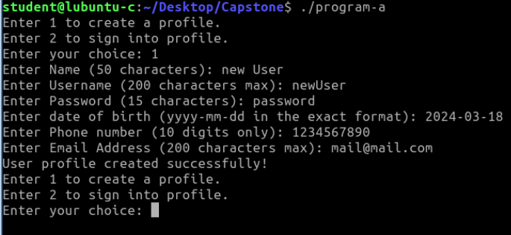
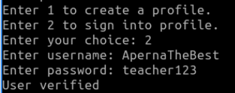
Sign Up/Sign In Functionality
Now let’s look at our code!
Notes:
First we will look at how to create a profile and sign into a profile then we will jump into the code that makes it all work.
When the user first opens the program they are met with 2 options to sign up or sign in. We will first look at sign in.
Mention error

Slide 16
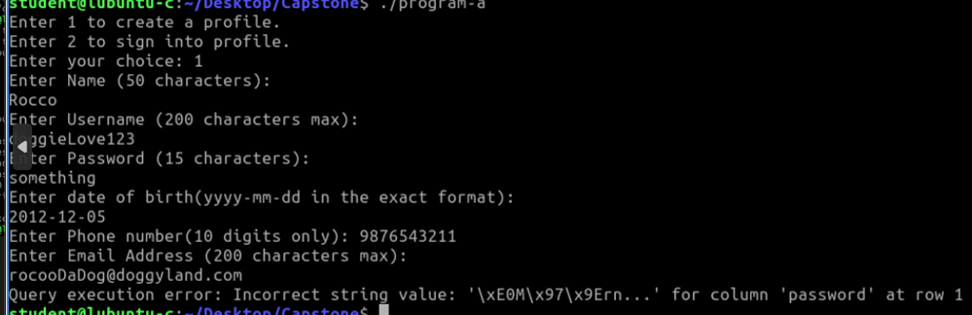
Sign Up Testing/Errors
White Space Errors
Program Continued After Error Messages Populated
Error Messages Did Not Populated
Notes:
Aysia:As we've just seen in the live demo, our sign-up and sign-in process is functional but like any system in development, it has areas we're actively refining."In our sign-up process, we encountered a couple of errors"White spaces in inputs can cause unexpected behavior. We implement format specifiers so the program knows to read the user input. "When errors occur, it's important the program doesn't crash but instead provides feedback. Our system is designed to alert users to the issue and prompt them to correct it without losing their other input data. As we tested we noticed the program continued after an error message was shown. We fixed this with while statements. On the opposite side we also had some error messages not show at all. We fixed this by making sure the query statements were correct and that our printf statements were in the correct place.

Slide 17
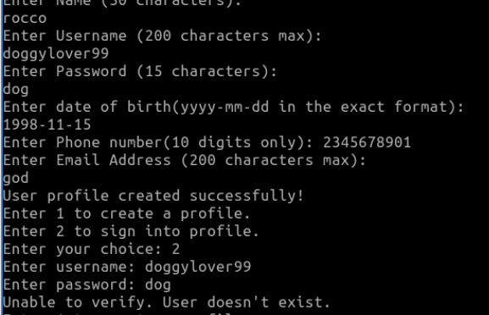
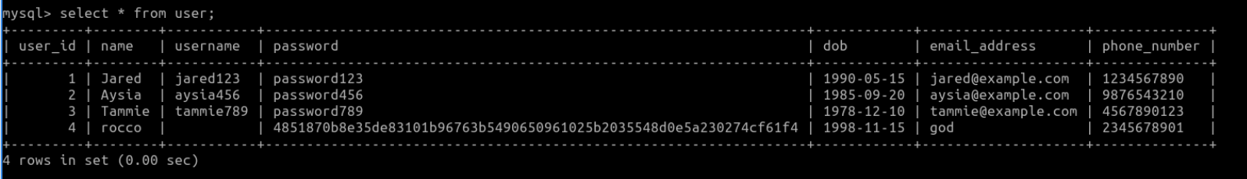
Password Hashing
Utilized Salt, SHA-256, and multiple
libraries such as openssl/rand.h, openssl/evp.h, openssl/sha.h
Managed to get the password to change, but unfortunately could not figure out why the username would not save
Eventually, We continued without including the function
Notes:
Jared:

Slide 18

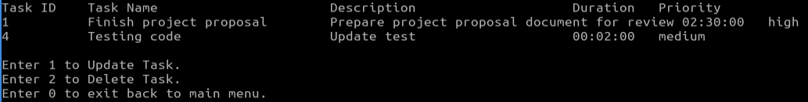
Create/Manage Tasks
Now Let’s look at our Code!
Notes:
Tammie:

Slide 19
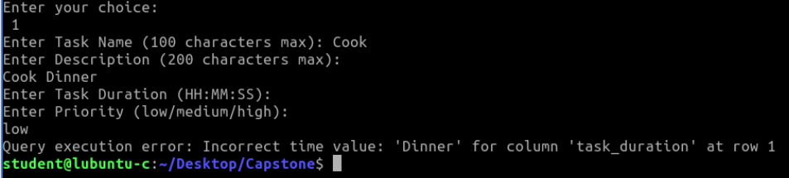
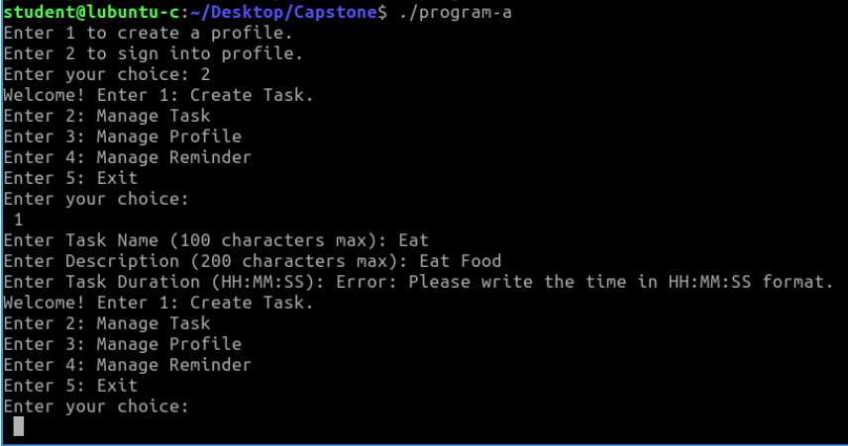
Task Function Testing/Errors
White Space Errors
Notes:
Aysia:

Slide 20
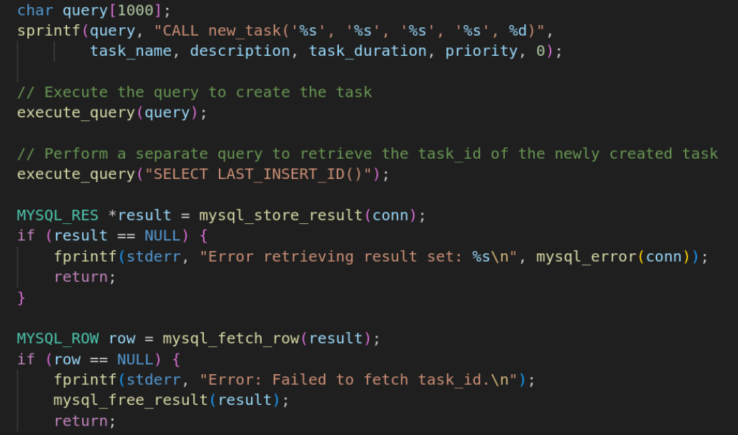
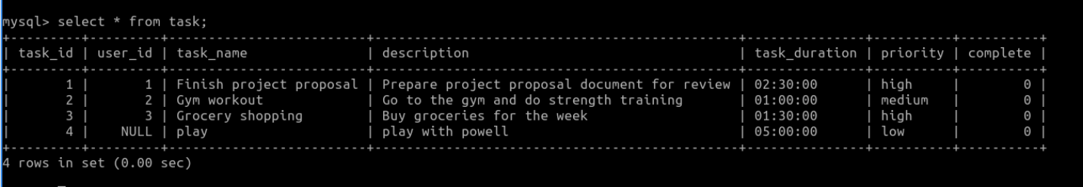
Task Functions Testing/Errors
User’s need to fill out a new task form. We
tried to receive the previous task ID and
was unable to get it.
Realized the current user was not being associated with the created Task. This led us to create a user and task struct. We also changed all the parameters to add the current User’s information.
Notes:
Aysia:

Slide 21
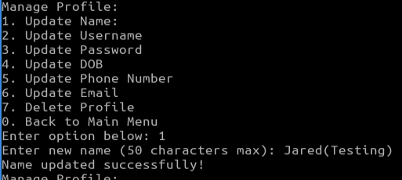
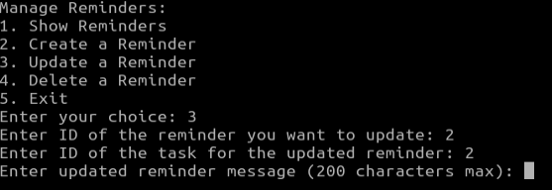
Manage Profile/Manage Reminders
Now let’s look at our code!
*Note: did not encounter any substantial or notable errors when writing/testing logic in this part of the code
Notes:
Jared:
The only true error that we encountered was that when you enter an ID that wasn’t in the database you could still continue to create a reminder but it never populated.

Slide 22
05
Bash Scripting
Database Design/Flowchart/Algorithms
Notes:
Tammie:

Slide 23
BASH - SCRIPT
Automated scripts for reports, reminders, and completed tasks.
#!/bin/bash
echo
Notes:
Tammie:

Slide 24
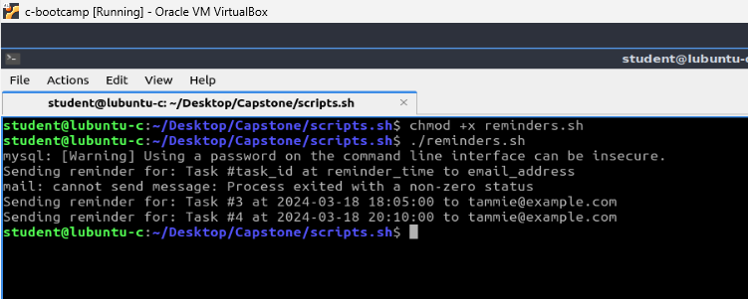
reminders.sh
Notes:
Tammie:

Slide 25
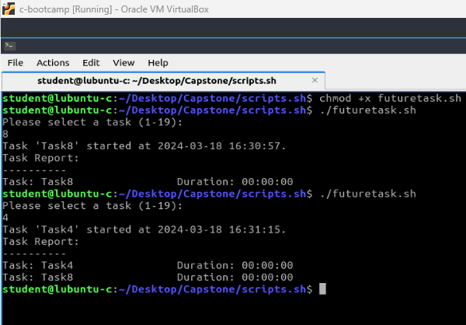
futuretask.sh
Notes:
Tammie:

Slide 26
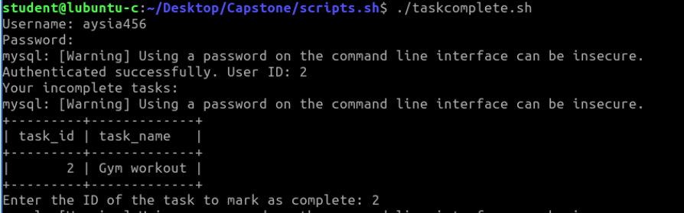
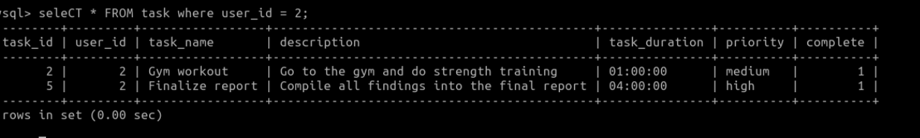
taskcomplete.sh
Notes:
Tammie:

Slide 27
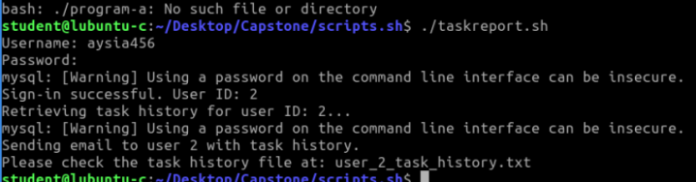
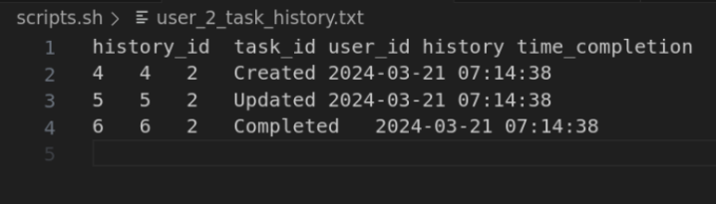
taskreport.sh
Notes:
Tammie:

Slide 28
Final Thoughts
—Jared Pierce
—Tammie IIlg
—Aysia Clay

Slide 29
Thanks!
Does anyone have any questions?
Please keep this slide for attribution

